Slide 1
Enrollment
Procedure

Slide 2
Error!
Please Follow the On-Screen
Instructions to Continue
Go Back

Slide 3
Complete
Please navigate to the next module
Within this course to continue
Start Over

Slide 4
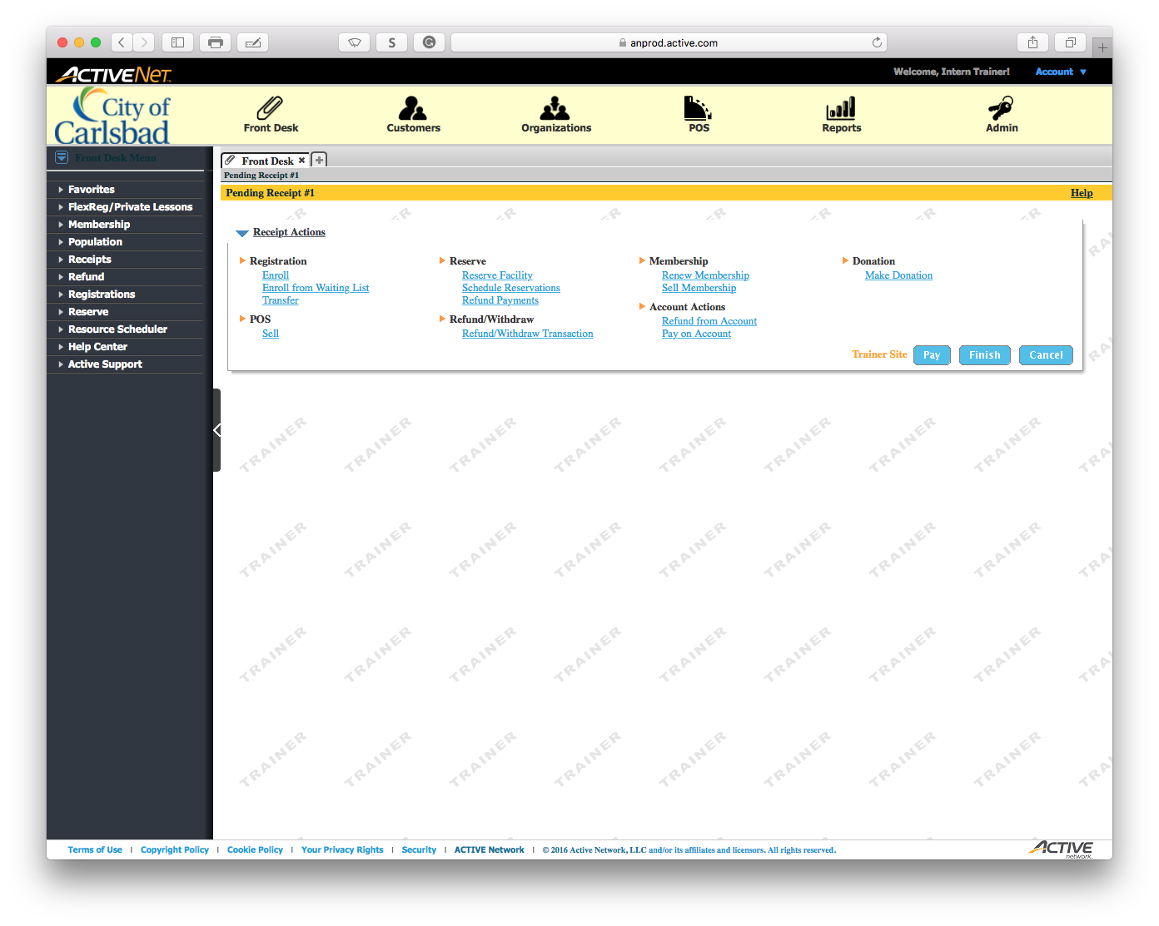
Main Text Instruction Will Go Here
Sub Instruction Here

Slide 5
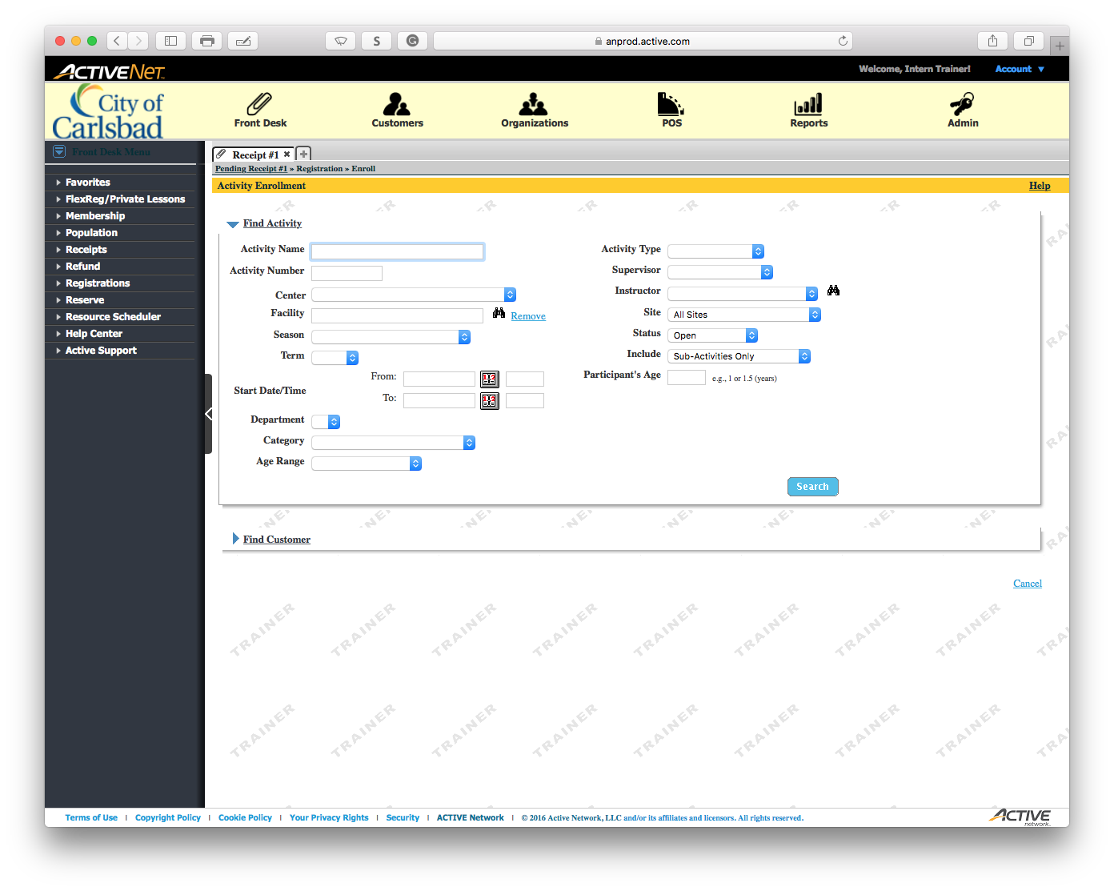
Main Text Instruction Will Go Here
Sub Instruction Here

Slide 6

Main Text Instruction Will Go Here
Sub Instruction Here

Slide 7
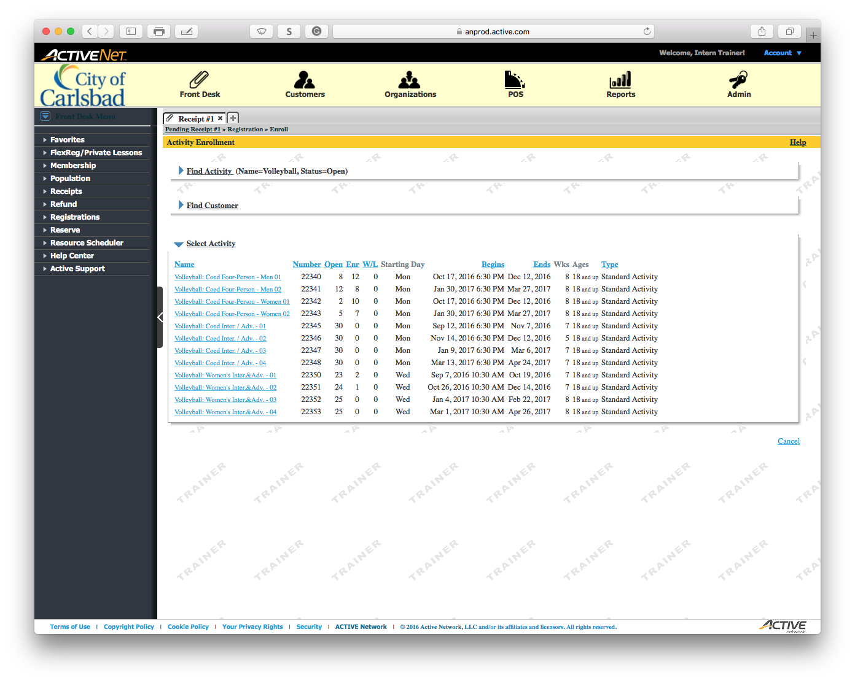
Main Text Instruction Will Go Here
Sub Instruction Here

Slide 8
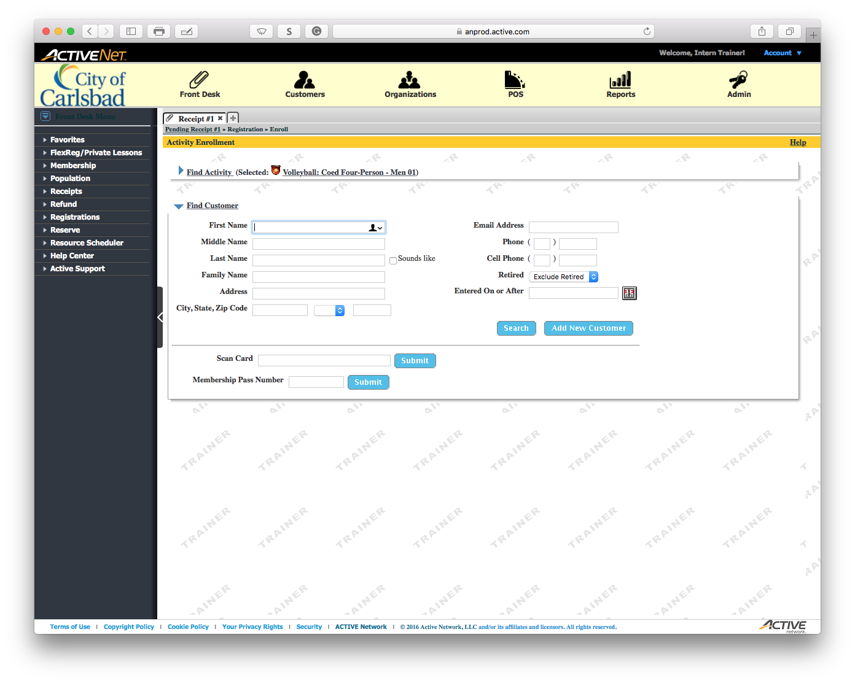
Main Text Instruction Will Go Here
Sub Instruction Here

Slide 9

Main Text Instruction Will Go Here
Sub Instruction Here

Slide 10

Main Text Instruction Will Go Here
Sub Instruction Here

Slide 11
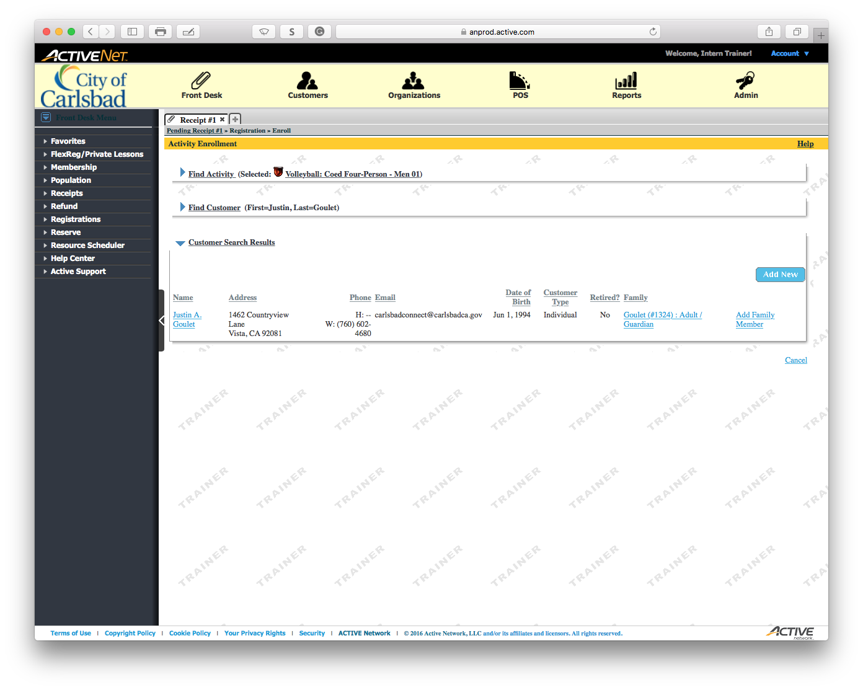
Main Text Instruction Will Go Here
Sub Instruction Here

Slide 12
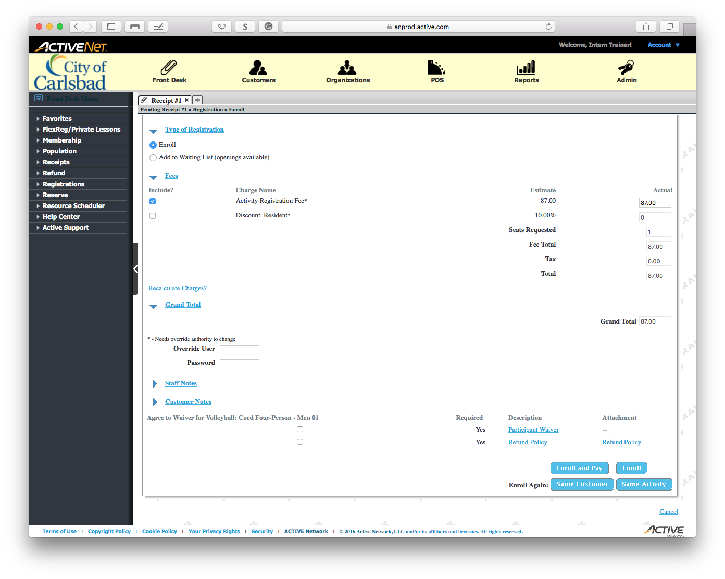
Main Text Instruction Will Go Here
Sub Instruction Here

Slide 13

Main Text Instruction Will Go Here
Sub Instruction Here

Slide 14

Main Text Instruction Will Go Here
Sub Instruction Here

Slide 15
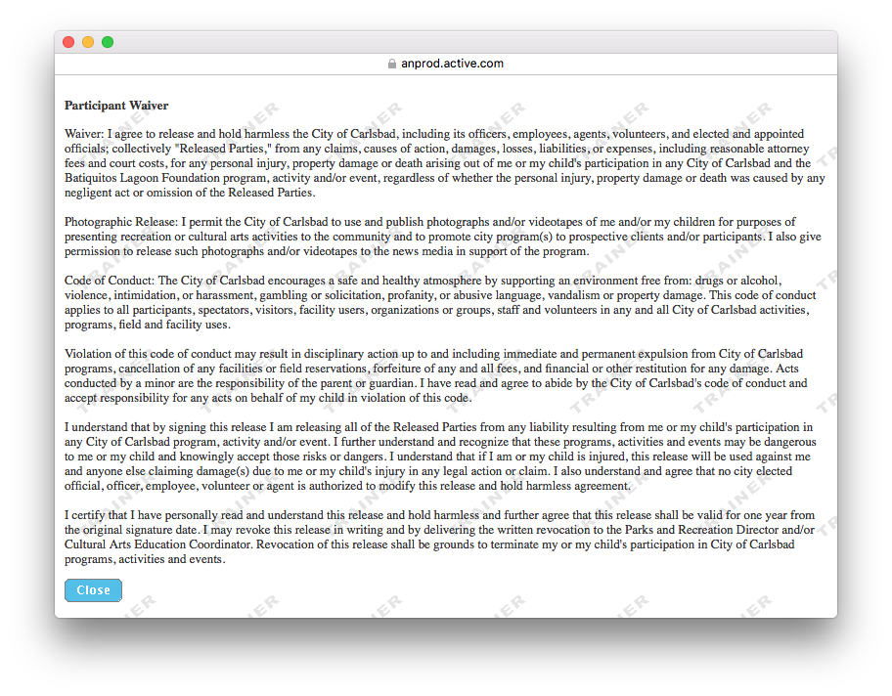
Main Text Instruction Will Go Here
Sub Instruction Here

Slide 16
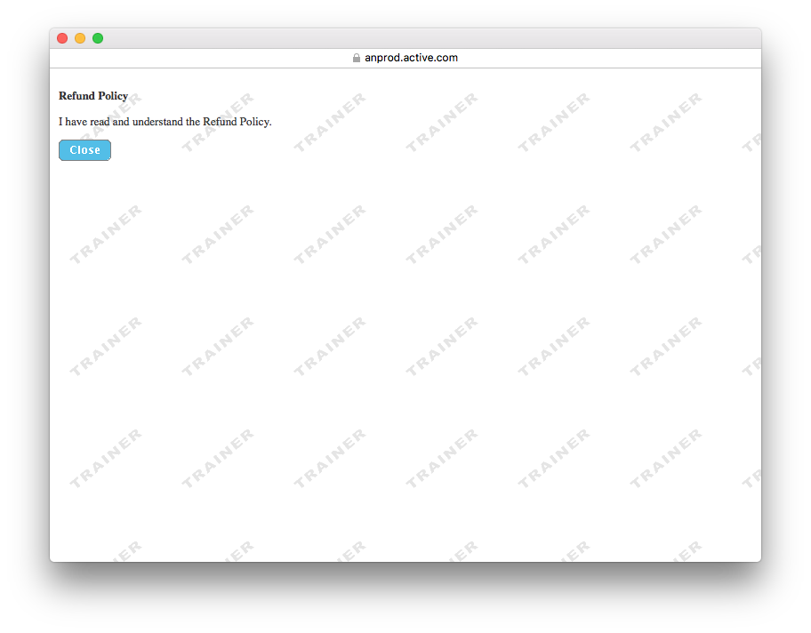
Main Text Instruction Will Go Here
Sub Instruction Here

Slide 17
Put Refund Policy Here
Main Text Instruction Will Go Here
Sub Instruction Here

Slide 18
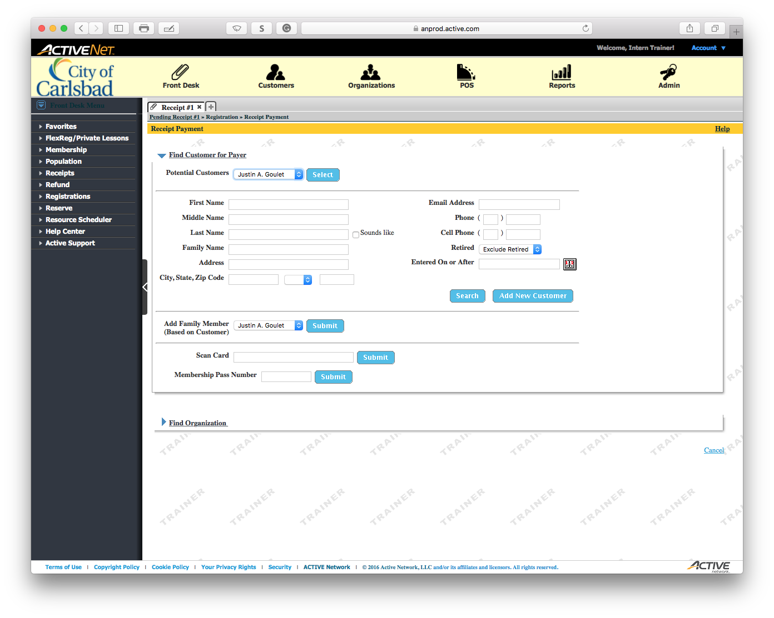
Main Text Instruction Will Go Here
Sub Instruction Here

Slide 19
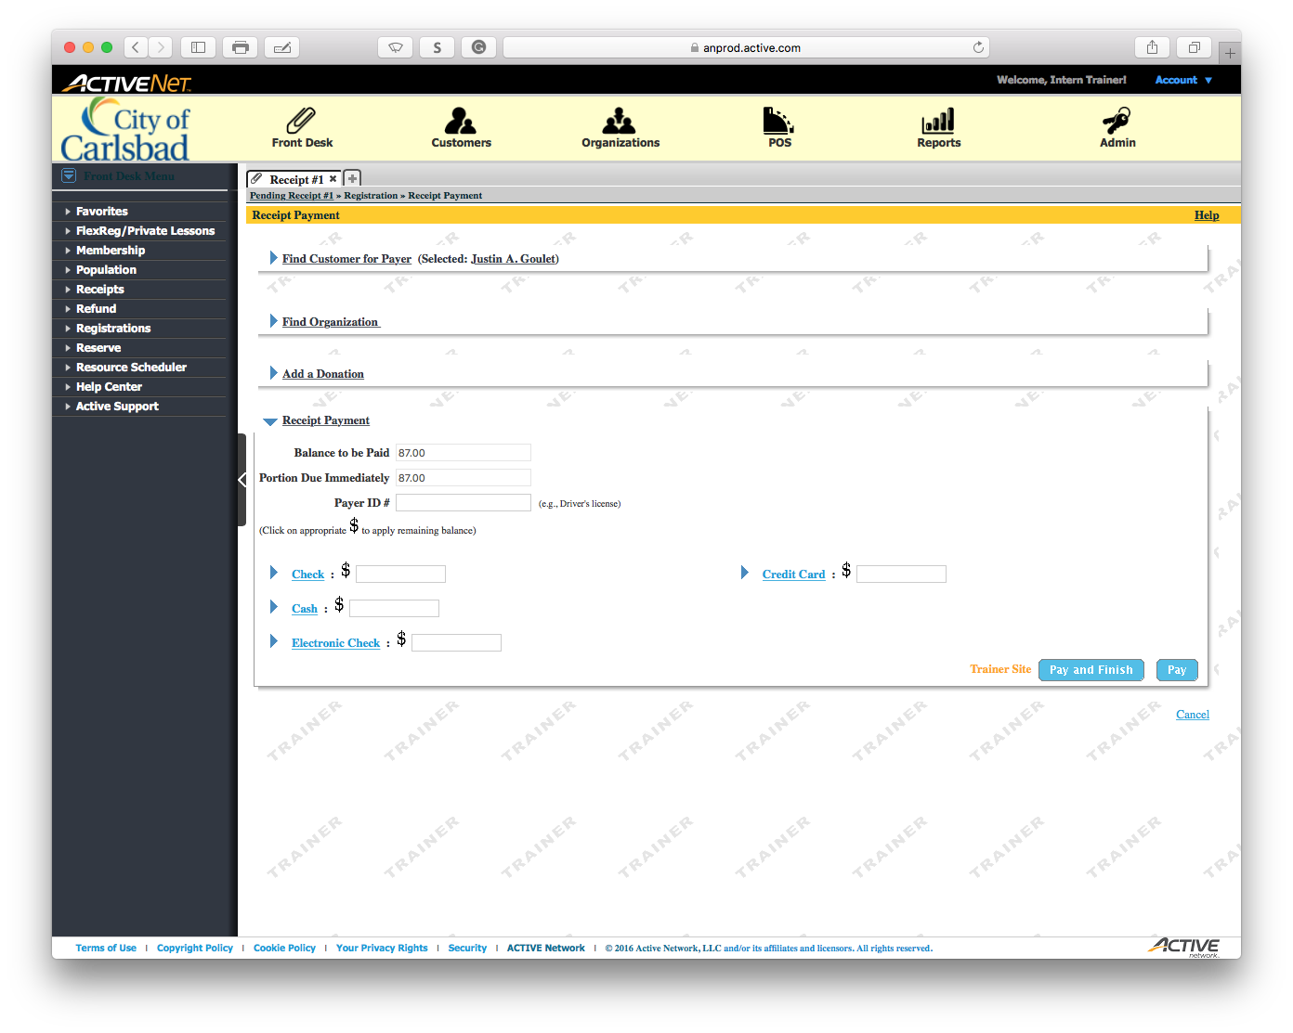
Main Text Instruction Will Go Here
Sub Instruction Here

Slide 20

Main Text Instruction Will Go Here
Sub Instruction Here

Slide 21
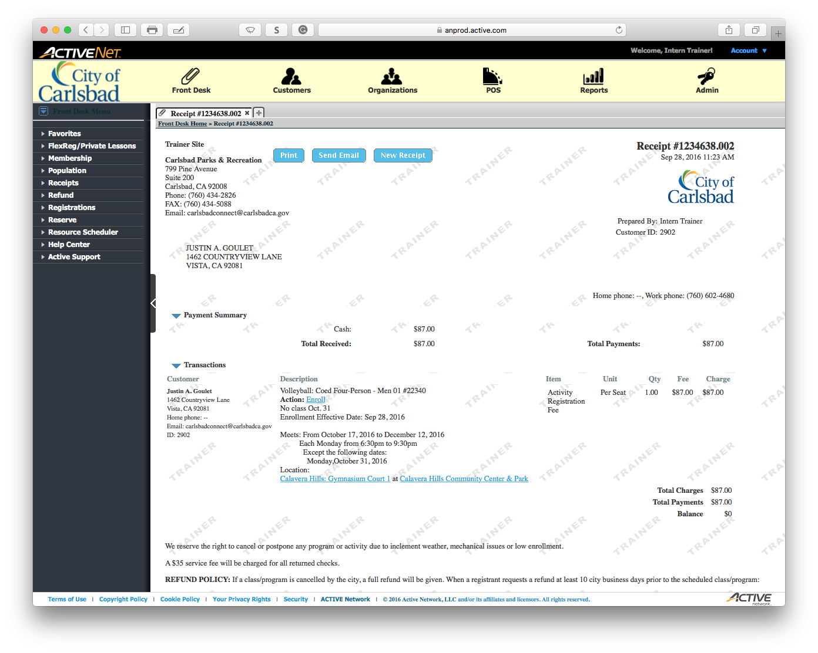
Main Text Instruction Will Go Here
Sub Instruction Here

Slide 22
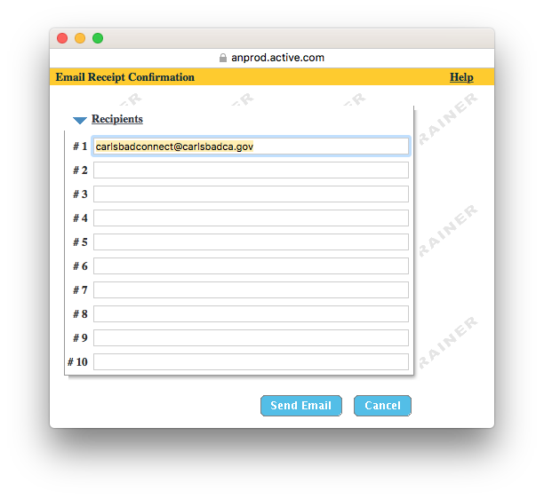
Main Text Instruction Will Go Here
Sub Instruction Here

